Slide 1
Seven Stages of Action
Video by Space Space from https://www.pexels.com/video/the-sun-illuminating-earth-s-surface-1851190/ (PD)

Slide 2
Learning Goals
Know how to apply Norman’s Seven Stages of Action
Avoid the gulf of evaluation and execution
Seven Stages of Action

Slide 3
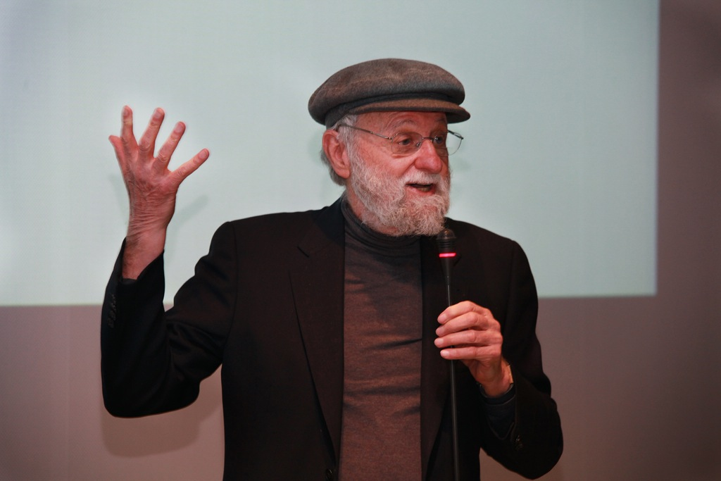
Don Norman
Photo by Paolo Sacchi / Meet the media Guru from https://www.flickr.com/photos/meetthemediaguru/5553249364/ (CC BY-SA 2.0)
Seven Stages of Action

Slide 4
Gulfs when interacting with the world
By Saviesa Home from https://www.pexels.com/photo/empty-two-black-chair-2089696 (PD)
there should be light!
the gulf of
execution
the gulf of
evaluation
a brighter world
a dark world
Seven Stages of Action
Notes:
The Gulf of Evaluation reflects the amount of effort needed to interpret the state of the system how well this can be compared to the intentions
Is the information about state of the system easily accessible?
Is it represented to ease matching with intentions?
The difference between the intentions and the possible actions is the Gulf of Execution
How directly can the actions be accomplished?
Do the actions provided by the system match the actions intended by the person?

Slide 5
Gulfs when interacting with the world
By Saviesa Home from https://www.pexels.com/photo/empty-two-black-chair-2089696 (PD)
there should be light!
the gulf of
execution
the gulf of
evaluation
a brighter world
a dark world
Seven Stages of Action

Slide 6
Seven Stages of Action
goals
intend to act
evaluate the interpretation
plan sequence of actions
interpret the perception
NASA Earth Observatory images by Robert Simmon, using Suomi NPP VIIRS data from Chris Elvidge (see https://earthobservatory.nasa.gov/blogs/elegantfigures/2013/04/22/earth-day-and-night)
Background by Francesco Ungaro from https://www.pexels.com/photo/starry-sky-998641/ (PD)
execute the action sequence
perceive the state of the world
Seven Stages of Action
Notes:
https://earthobservatory.nasa.gov/blogs/elegantfigures/2013/04/22/earth-day-and-night/
https://www.pexels.com/photo/starry-sky-998641/

Slide 7
Why Niels Can’t Record
goals
record long videos
clean up phone
evaluate the interpretation
intend to act
couldn’t record long videos
delete trash, cache, videos
interpret the perception
plan sequence of actions
video very short
NASA Earth Observatory images by Robert Simmon, using Suomi NPP VIIRS data from Chris Elvidge (see https://earthobservatory.nasa.gov/blogs/elegantfigures/2013/04/22/earth-day-and-night)
Background by Francesco Ungaro from https://www.pexels.com/photo/starry-sky-998641/ (PD)
perform actions on my phone
perceive the state of the world
execute the action sequence
my phone is not recording
Seven Stages of Action
Notes:
https://earthobservatory.nasa.gov/blogs/elegantfigures/2013/04/22/earth-day-and-night/
https://www.pexels.com/photo/starry-sky-998641/

Slide 8
Evaluation and Design Questions
Avoid the gulf of evaluation
Can the user tell what state the system is in?
Can the user tell if the system is in the desired state?
Can the user map from the system state to an interpretation?
Avoid the gulf of execution
Can the user tell what actions are possible?
Does the device easily support required actions?
Does the interface help with mapping from intention to physical movement?
Seven Stages of Action

Slide 9
Implications on Design
Critical points
Forming inadequate goal
Not knowing the appropriate action
Not finding the correct action
Receiving inappropriate feedback
Principles of good design
System state and actions are always visible
Good conceptual model with a consistent system image
Interfaces include good mappings that show the relationship between stages
Continuous feedback to the user
Seven Stages of Action

Slide 10
License
This file is licensed under the Creative Commons Attribution-Share Alike 4.0 (CC BY-SA) license:
https://creativecommons.org/licenses/by-sa/4.0
Attribution: Niels Henze
For more content see: https://hci-lecture.de

